Slide 1
Finite Automata
Chapter-2

Slide 2
Types of Finite Automata (FA)
There are two types of finite automata (FA):
Deterministic Finite Automata (DFA)
Can be one and only one state at a time
Nondeterministic Finite Automata (NFA)
Can be in several states at once
input₁
input₁
q₁
q₂
q₁
q₂
input₁
q₃
DFA
NFA

Slide 3
Deterministic Finite Automata (DFA)
A formalism for defining languages, consisting of:
A finite set of states (Q, typically).
A finite set of input symbols (Σ, typically).
A transition function (δ, typically).
A start state (q₀, one of the states in Q, typically).
A set of final states (F ⊆ Q, typically).
“Final” and “accepting” are synonyms.
So, A DFA is a five-tuple notation:
A=(Q, Σ, δ, q₀, F)
where A is the name of the DFA.

Slide 4
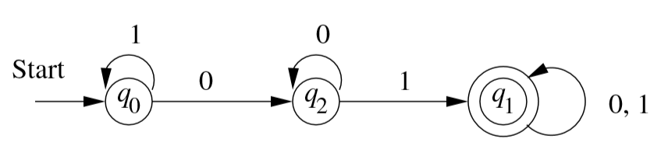
DFA (contd…)
DFA can be described as follows:
({q₀, q₁, q₂}, {0,1}, δ, q₀, {q₁})

Slide 5
Transition Function (δ)
Takes two arguments:
a state, and
an input symbol.
δ(q, a) = the state that the DFA goes to when it is in state q and input a is received.
a
q
p
δ(q, a)=p

Slide 6
Simpler Notations for DFA’s
Two preferred notations for describing automata:
Transition diagram
Graph representation of the δ function.
Transition table
Tabular representation of the δ function.

Slide 7
Transition Diagram
({q₀, q₁, q₂}, {0,1}, δ, q₀, {q₁})
A transition diagram for a DFA A=(Q, Σ, δ, q₀, F) is a graph defined as follows:
For each state in Q there is a node.
Nodes=States
For each state q in Q and each input symbol a in Σ, let δ(q, a) =p
Arcs represent transition function.
Arc from state p to state q labeled by all those input symbols that have transitions from p to q.
Arrow labeled “Start” to the start state, q₀
This arrow does not originate at any node.
Final states (those in F) indicated by double circles.
States not in F have a single circle.

Slide 8
Alternative Representation: Transition Table
A transition table is a conventional, tabular representation of a function like δ that takes two arguments and returns a value.
Final states
starred
Columns =
input symbols
0
1
*
A A B
B A C
C C C
Arrow for
start state
*
Rows = states

Slide 9
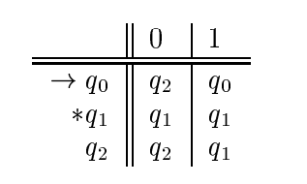
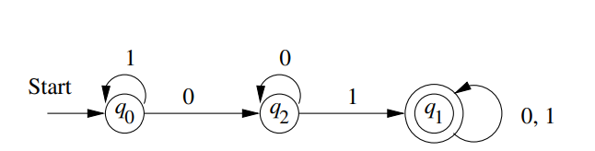
Transition Table & Transition Diagram (cont’d)

Slide 10
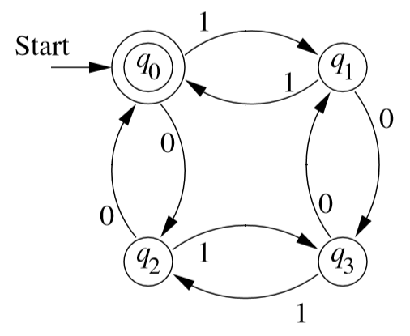
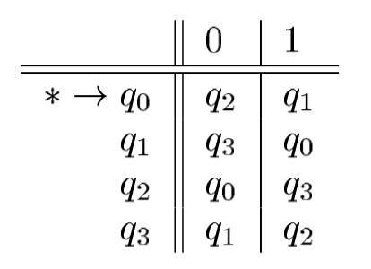
Transition diagram -> Transition table (vice versa)
Diagram to Table
Table to Diagram
Transition Diagram
Transition Table

Slide 11
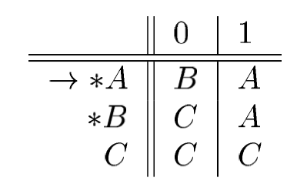
Try Yourself (Take 3 minutes for each)
1. Show a transition table for the following diagram/automata:
2. Draw a transition diagram from the following table:

Slide 12
How a DFA process Strings?

Slide 13
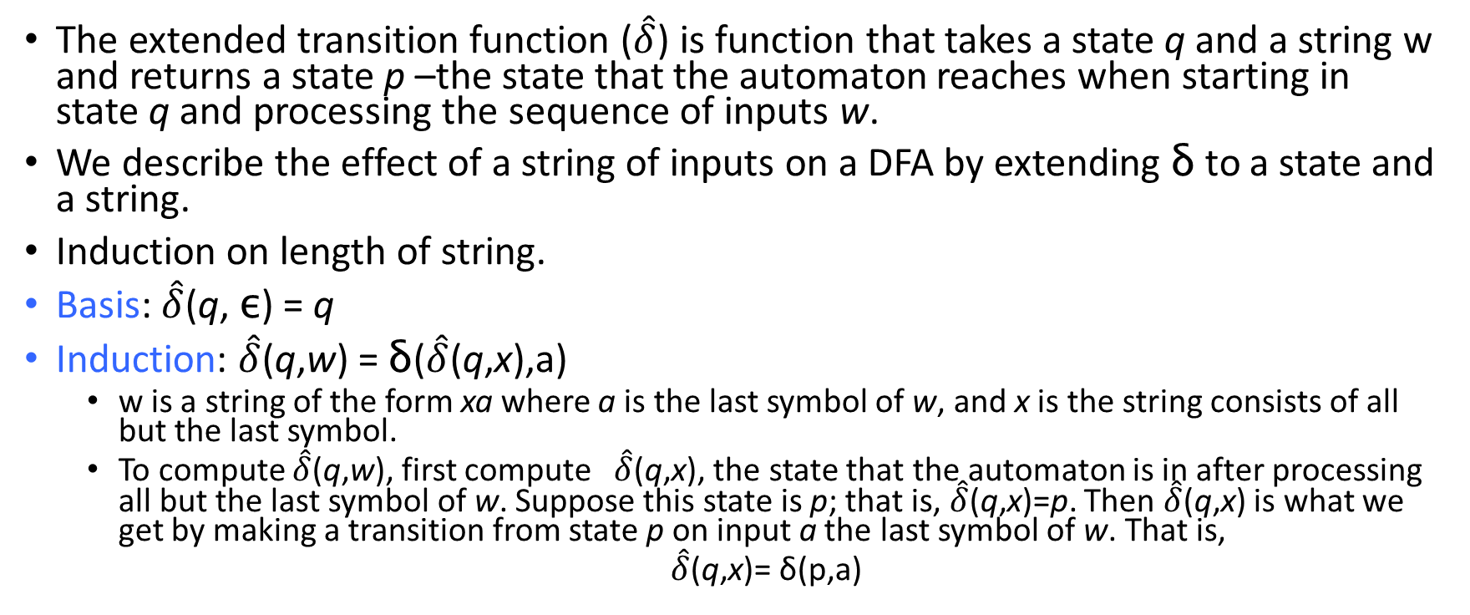

Extended Transition Function ($\hat{δ}$)
The extended transition function ($\hat{δ}$) is function that takes a state q and a string w and returns a state p –the state that the automaton reaches when starting in state q and processing the sequence of inputs w.
We describe the effect of a string of inputs on a DFA by extending δ to a state and a string.
Induction on length of string.
Basis: $\hat{δ}$(q, ε) = q
Induction: $\hat{δ}$(q,w) = δ($\hat{δ}$(q,x),a)
w is a string of the form xa where a is the last symbol of w, and x is the string consists of all but the last symbol.
To compute $\hat{δ}$(q,w), first compute $\hat{δ}$(q,x), the state that the automaton is in after processing all but the last symbol of w. Suppose this state is p; that is, $\hat{δ}$(q,x)=p. Then $\hat{δ}$(q,x) is what we get by making a transition from state p on input a the last symbol of w. That is,
$\hat{δ}$(q,x)= δ(p,a)

Slide 14

Extended Transition Function (contd…)
In book, the extended δ has a “hat” to distinguish it from δ itself.
Not needed, because both agree when the string is a single symbol.
$\hat{δ}$(q, a) = δ($\hat{δ}$(q, ε), a) = δ(q, a)
Extended deltas

Slide 15

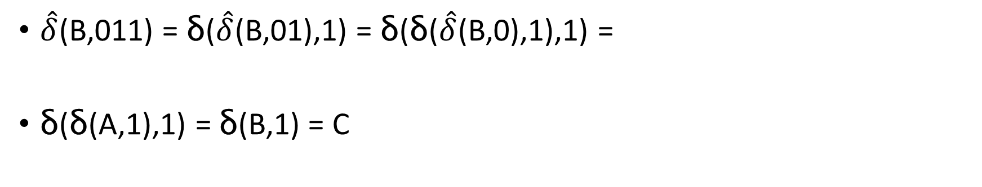
Example: Extended Delta
w= xa
$\hat{δ}$(q,w) = δ($\hat{δ}$(q,x),a)
$\hat{δ}$(B,011)
=δ($\hat{δ}$(B,01),1)
=δ($\text{δ}(\hat{δ}$(B,0),1),1)
= δ($\text{δ}(A$,1),1)
= δ(B,1)
= C
0
1
A A B
B A C
C C C
*
$\hat{δ}$(B,011) = δ($\hat{δ}$(B,01),1) = δ(δ($\hat{δ}$(B,0),1),1) =
δ(δ(A,1),1) = δ(B,1) = C

Slide 16

Let’s try yourself
Given
Show how to process a string 110101?
The steps of processing a string 110101 using $\hat{δ}$ are as follows:
Or
As the DFA is at q₀ state after processing the given string and q₀ is a final state of the NFA, the string is accepted for the DFA.

Slide 17
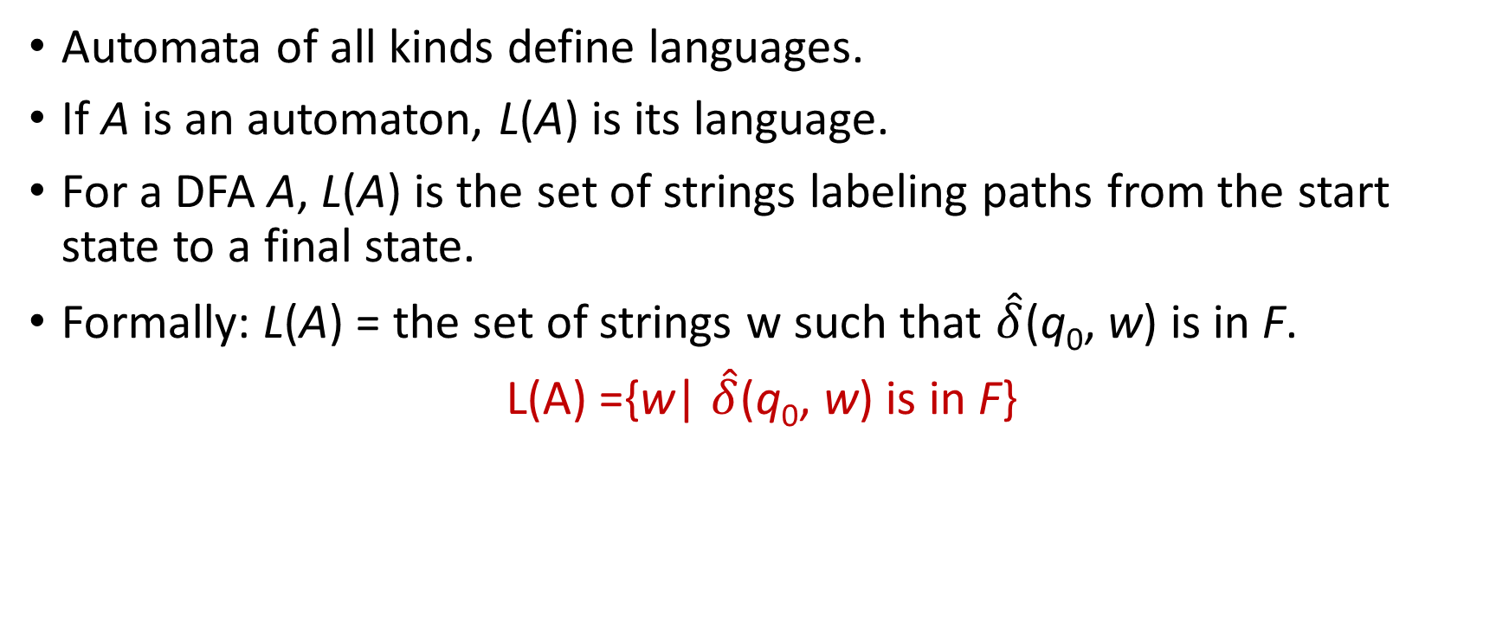
Language of a DFA
Automata of all kinds define languages.
If A is an automaton, L(A) is its language.
For a DFA A, L(A) is the set of strings labeling paths from the start state to a final state.
Formally: L(A) = the set of strings w such that $\hat{δ}$(q₀, w) is in F.
L(A) ={w| $\hat{δ}$(q₀, w) is in F}

Slide 18
How to draw a DFA from a Language?

Slide 19
Example 1
Draw a DFA for the following language over Σ ={0,1}
The set of all strings ending in 00.
L(D)={00, 100, 1100, 10100,…}
1
0
Start
0
0
q₁
q₂
q₃
1
1

Slide 20
Example 1 (cont’d)
Processing the string 100100
1
0
Start
0
0
q₁
q₂
q₃
1
1

Slide 21
Example 1 (cont’d)
Processing the string 100100
1
0
Start
0
0
q₁
q₂
q₃
1
1

Slide 22
Example 1 (cont’d)
Processing the string 100100
1
0
Start
0
0
q₁
q₂
q₃
1
1

Slide 23
Example 1 (cont’d)
Processing the string 100100
1
0
Start
0
0
q₁
q₂
q₃
1
1

Slide 24
Example 1 (cont’d)
Processing the string 100100
1
0
Start
0
0
q₁
q₂
q₃
1
1

Slide 25
Example 1 (cont’d)
Processing the string 100100
1
0
Start
0
0
q₁
q₂
q₃
1
1

Slide 26
Example 1 (cont’d)
Processing the string 100100
1
0
Start
0
0
q₁
q₂
q₃
1
1
Accepted

Slide 27
Example 1 (cont’d)
Processing the string 010
1
0
Start
0
0
q₁
q₂
q₃
1
1

Slide 28
Example 1 (cont’d)
Processing the string 010
1
0
Start
0
0
q₁
q₂
q₃
1
1

Slide 29
Example 1 (cont’d)
Processing the string 010
1
0
Start
0
0
q₁
q₂
q₃
1
1

Slide 30
Example 1 (cont’d)
Processing the string 010
1
0
Start
0
0
q₁
q₂
q₃
1
1
Rejected

Slide 31
Draw a DFA for the following language over Σ ={0,1}
The set of all strings ending in 01.
1
0
Start
0
1
q₁
q₂
q₃
0
1

Slide 32
Example 2
Draw a DFA for the following language over Σ ={0,1}
The set of all strings with 011 as a substring.
L(A)={011, 00110, 1101101, …}
1
0
0,1
Start
0
1
1
q₁
q₂
q₃
q₄
0

Slide 33
TRY!!!
Try the following:
The set of all strings ending in 011.
The set of all string with 01 as a substring.
Draw a DFA for the following language over Σ ={a,b,c}
The set of all strings ending in bc.

Slide 34
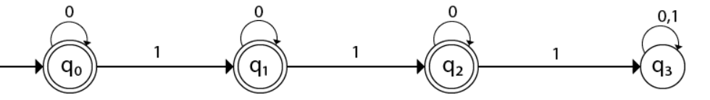
Example 3
Design a DFA L(M) = {w | w ε {0, 1}*} and W is a string that does not contain three consecutive 1’s.
L(A)={ε ,1, 00, 010, 11, 1101,…}

Slide 35
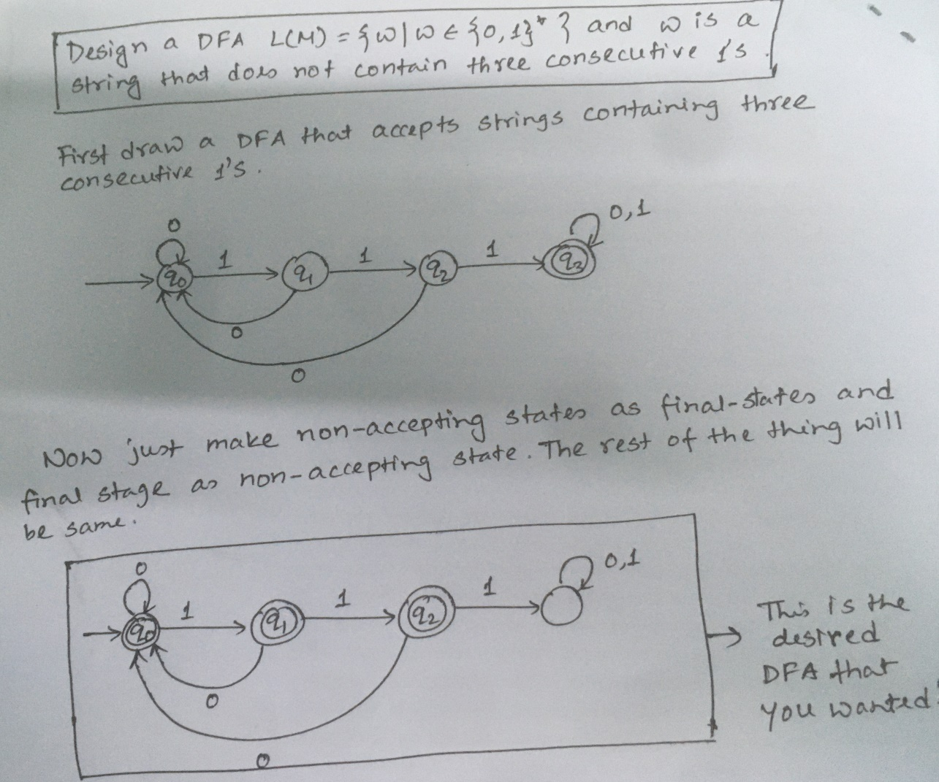
Tips!!!

Slide 36
Homework
Draw a DFA for the following language over Σ ={0,1}
The set of all strings with three consecutive 0’s (not necessarily at the end).
The set of all strings with not having two consecutive 1’s (not necessarily at end).
The set of strings containing two consecutive zero’s followed by two consecutive ones.
Draw a DFA for the following language over Σ ={a,b,c}
The set of all strings with aba is a substring.
Exercise in different ways to be more CONFIDENT!!!!

Slide 37
Checkout
Solutions to Selected Exercises of your TEXTBOOK
http://infolab.stanford.edu/~ullman/ialcsols/sols.html

Slide 38
? Questions

